Slide 1
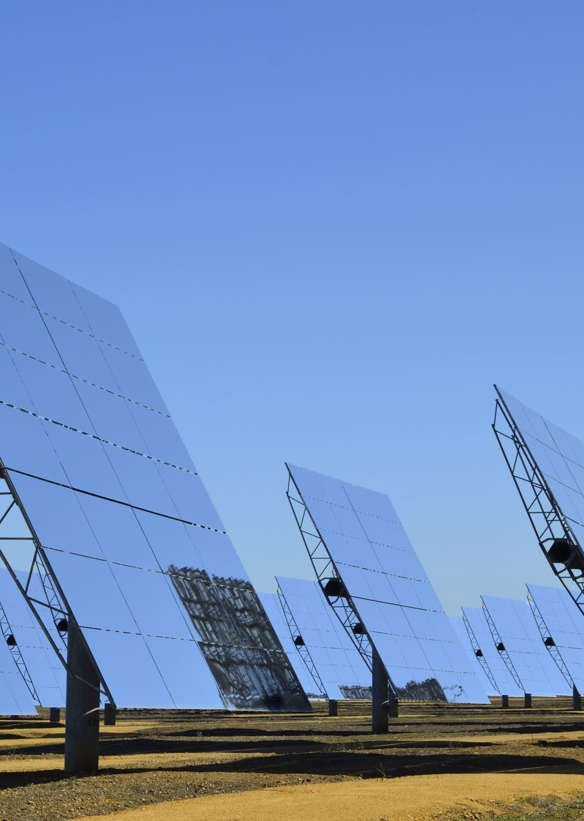
Solar 2025
Design and Implementation
By Glenn West (glenn_west@hotmail.com)
931-881-7446
Copyright @ 2025

Slide 2
Purpose
Purpose – Design a hybrid electric system that allows for self sufficiency and continues operation of household, office, and workshop.
Must leverage Utility Power, Solar Power, and Generator to make the best of all 3.
Reduce monthly electric bill to “manageable sum”.
Make it easy to service and have as easy to install as possible.
Make sure uptime is a high as possible.
Lack of power can equal severe problems for life and work

Slide 3
Motivations
Power Reliability
Power failure in sub-freezing for a week, almost took me out
To work I need power and electricity
Almost monthly failures in algood.
6 Hours this month and counting.
Power Cost - $250-300 a month is not a great price, and its going higher
Generator is noisy, and Natural Gas/Propane are not cheap.

Slide 4
Size. - Very different NEEDS
Systems can be as small as 100Watts to 100’s of kilowatts
Target for our discussion is “whole-house”, with a modern house
Min is 16KW, with the system being 32KW, and ease of expansion to 48KW
Assumes a 200Amp utility service

Slide 5
Modules
Module
Module 1 – Issues, Theories, and Problems
Module 2 – Physical Plant/Design Implementation
Module 3 – Electrical, Settings

Slide 6
Module 1 – Issues, Theories, and Problems
Issues
Theories
Problems

Slide 7
Module 1 - Issues
Knowledge in the local community
Electricians just refusing to accept project – Not Done That
Contractors having no clue
Cheating/Scalping
Companies that are “selling” solar with no battery
No definition of what your getting
And not getting much
Cross Trades Issues
Roof Guys don’t want it, “Invalidate warranty”, when there is no penetrations.

Slide 8
Module 1 - Issues
Cross Trades Issues
Roof Guys don’t want it, “Invalidate warranty”, when there is no penetrations.
Complexity Issues
Number of additional Boxes
Torque Issues
System Compatibilities
AC Coupled – DC Coupled
Compliance
Building code differences
HOA

Slide 9
Theories
System Types
AC Coupled / DC Coupled
Grid Connected / Off-Grid / Hybrid
Solar Panels – Types – Connections – Standards
Mounts
Safety
Inverters – Types and Kinds
Batteries – Types and Kinds
Meter to Inverter ”Accessories”

Slide 10
System Types
AC Coupled
DC Coupled
GRID Connected
OFF-GRID
HYBRID

Slide 11
System Types – AC Coupled
What Is IT:
What if everything is AC – 110-120V AC
OOPS: Solar panels are DC
So How:
Microinverters
MOST FAMOUS Brands
TESLA Power Wall
ENPHASE

Slide 12
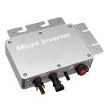
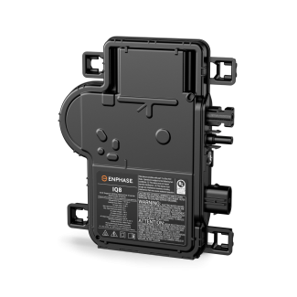
AC Coupled – What is a micro-inverter
A microinverter is a small device that changes direct current (DC) electricity from solar panels into alternating current (AC) electricity
Microinverters are installed on individual solar panels
The operate independently of other inverters in the system
Each panel produces independently
They can track performance of each panel in real-time
AC Is connected in “Parallel” in a micro-inverter system

Slide 13
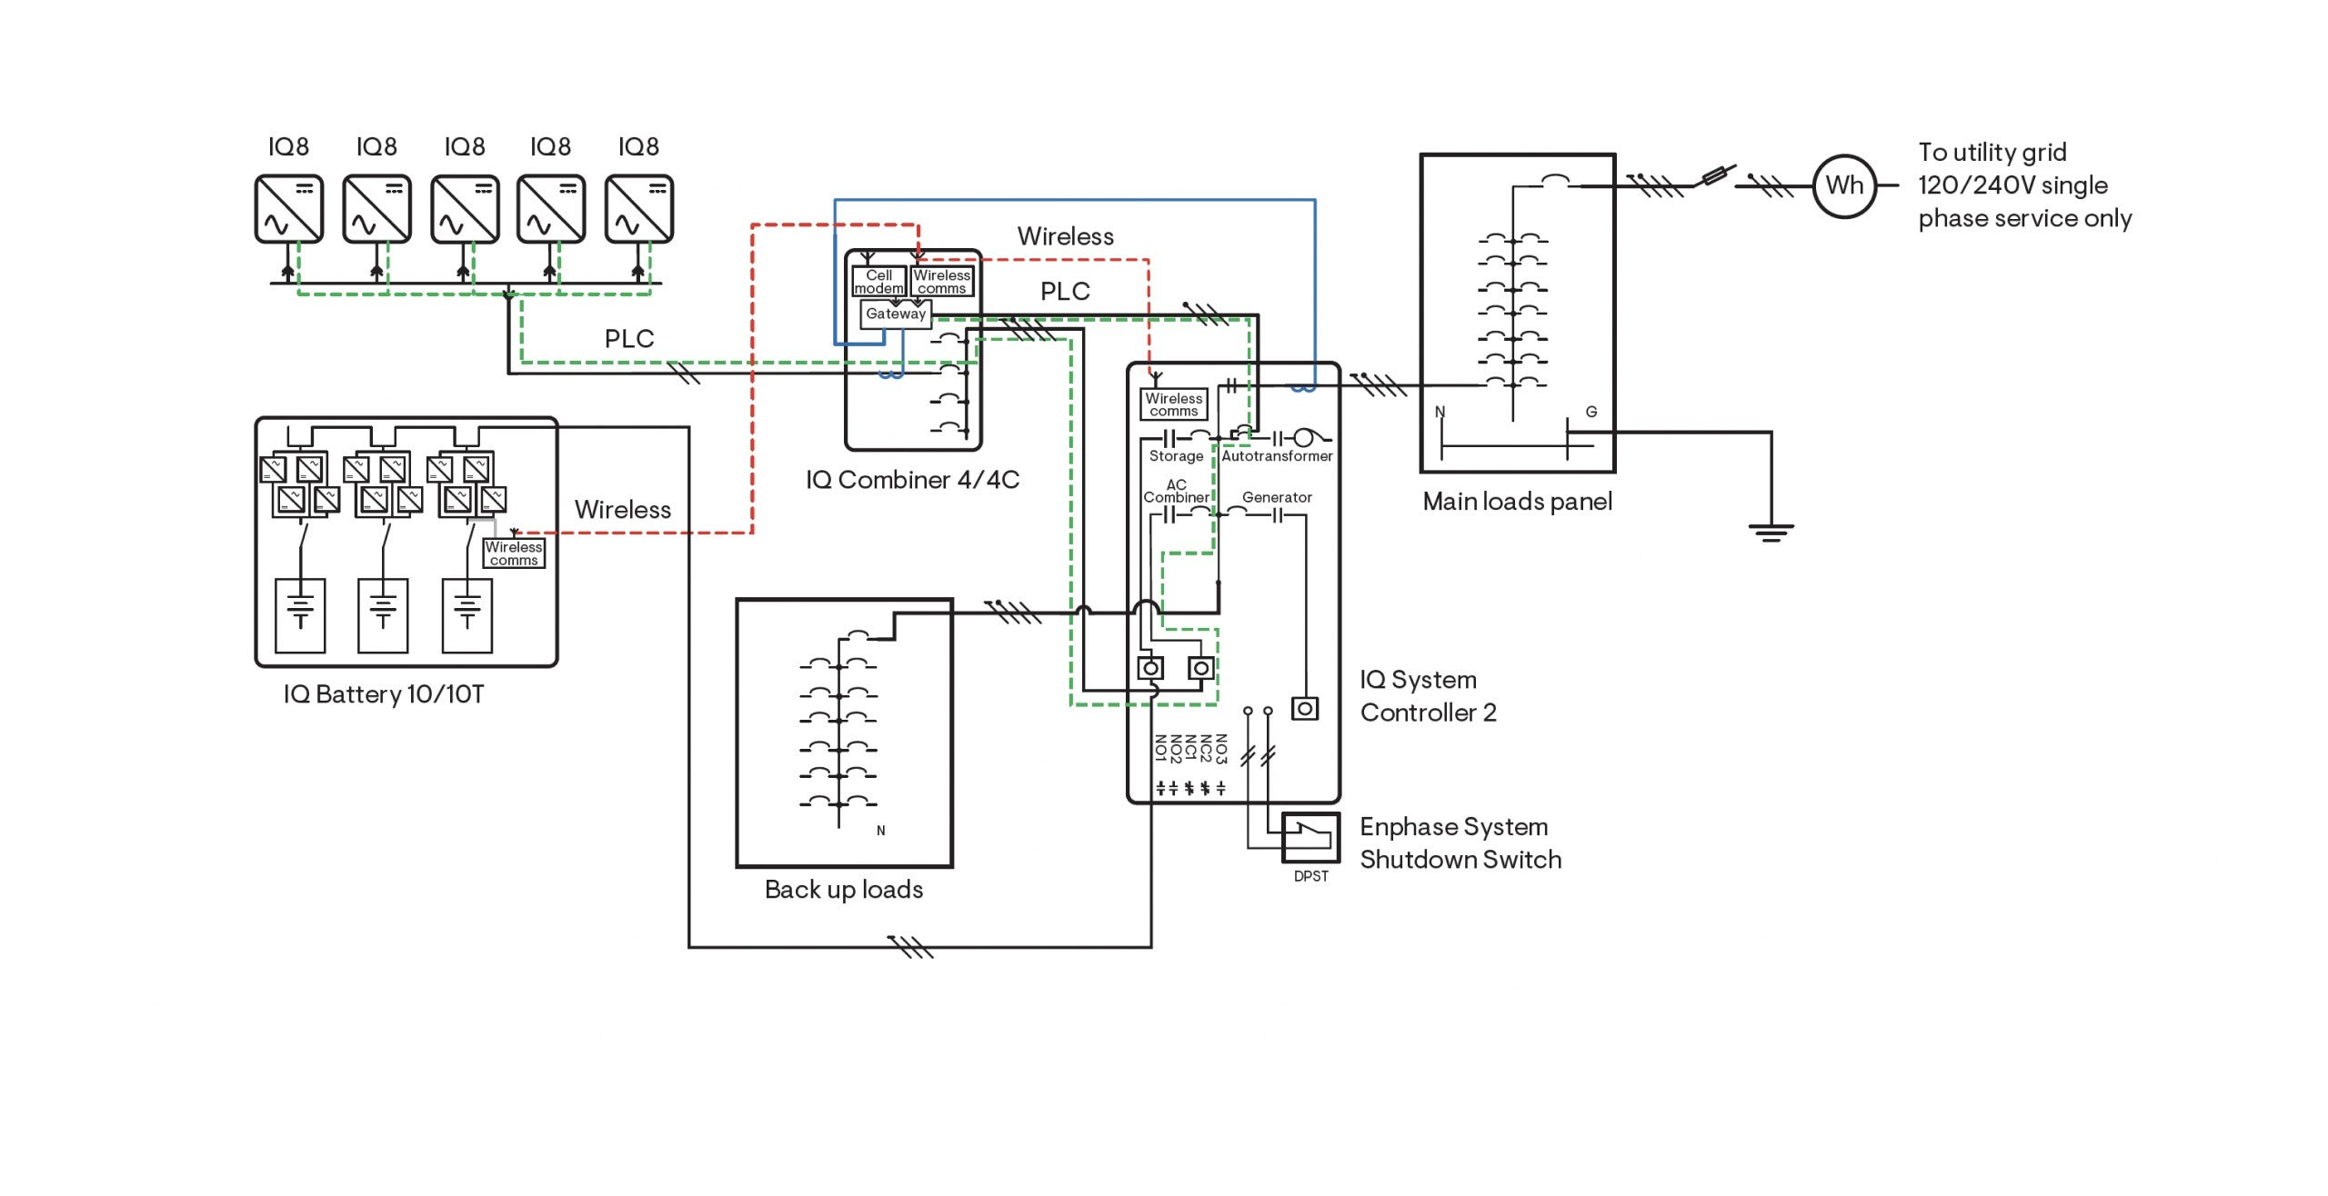
System DIAGRAM

Slide 14
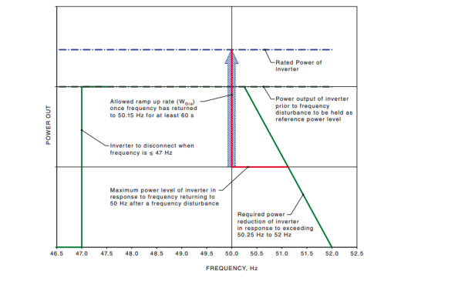
AC COUPLED
Cross Vendor Compatibility
While there is standards – details become “analog” wave form issues,
AS4777.2
Mixing and Matching gets to be difficult
Batteries are DC!
Need inverters on top
Need specific vendor training
Need multiple vendor training to hope to mix and match

Slide 15
System Diagram – AC Coupled

Slide 16
System Types – DC Coupled
Traditional Solar Solution
Solar Panels are DC devices
Batteries are DC Devices
Components
Panels
Inverters
Batteries
Accessories and safety devices
Mix and Match

Slide 17
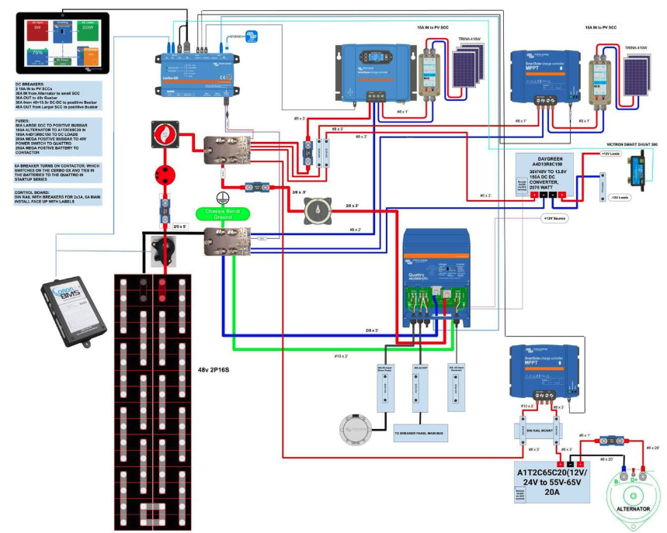
EXAMPLE – Old SCHOOL – Box Centric

Slide 18
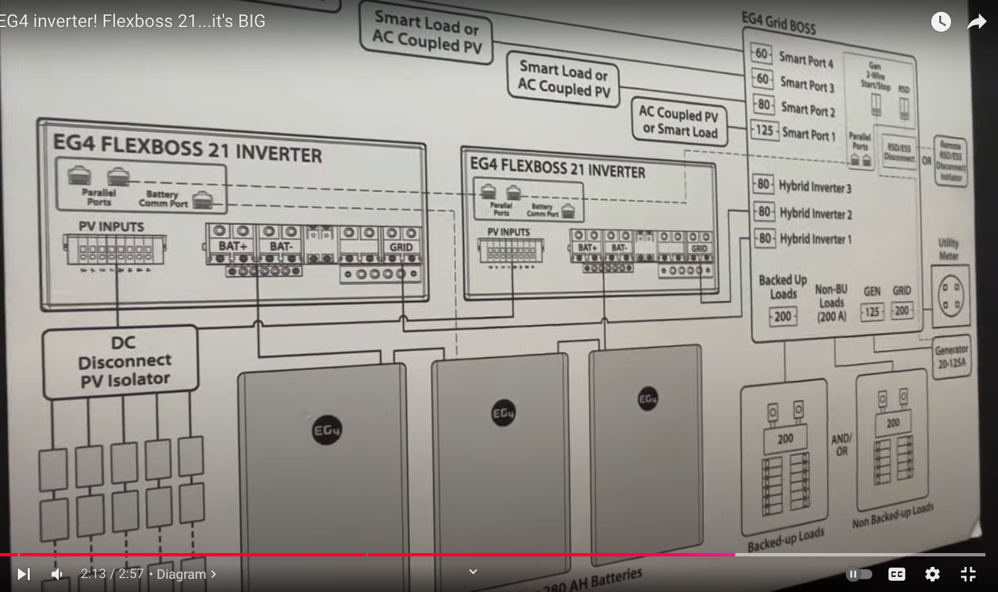
EXAMPLE – NEW SCHOOL – ALL-IN-ONE

Slide 19
System Types – Grid Connected
Definition: A grid-connected system allows you to power your home or small business with renewable energy during those periods (daily as well as seasonally) when the sun is shining, the water is running, or the wind is blowing. Any excess electricity you produce is fed back into the grid. When renewable resources are unavailable, electricity from the grid supplies your needs, eliminating the expense of electricity storage devices like batteries.
Power failure from Grid/Utility results in power failure to house
Most common grid connected are AC Coupled – Difficult to add batteries
Intense framework/regulation on grid connected – Power flow is bidirectional – Don’t electrocute linemen

Slide 20
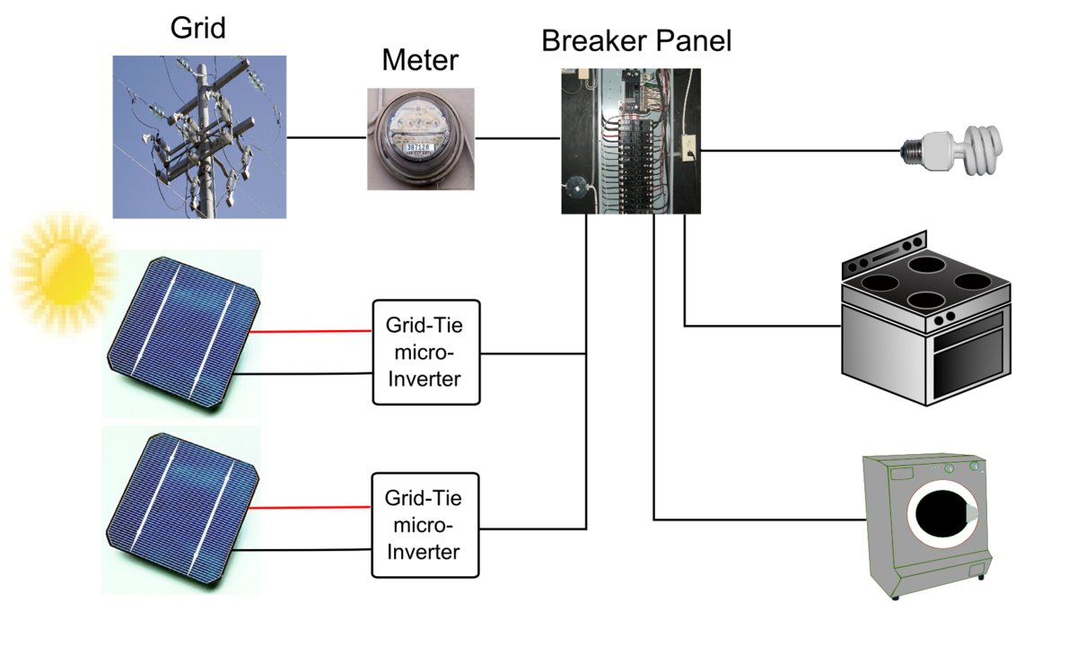
Grid Connected Components
AC Coupled:
Panels
Micro-Inverters
Accessories and safety devices
Power on wrong side of breaker ☺
Utility Meter
DC Coupled
Panels
Inverter
Accessories and Safety devices
Utility Meter

Slide 21
OFF-Grid System
Definition: Off-grid solar means a solar panel system is not connected to the utility grid. Instead, it generates electricity directly from the sun and stores it in batteries.
No grid is needed or included. No utility meter.
Batteries are required
Electricity any where there is sun – Alaska may get interesting in “winter”
Compared to grid connected:
Delete the meter
Add a one or more batteries

Slide 22
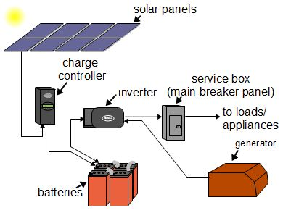
System Types – Off-Grid components
AC Coupled
Panels
Micro Inverters
Battery with inverters inside
Accessories and safety devices
DC Coupled
Panels
Inverter
Battery
Accessories and safety devices

Slide 23
System Types – Hybrid
Definition: A solar hybrid system is a renewable energy system that uses solar photovoltaic (PV) panels to generate clean energy to power your home. A hybrid solar system intelligently switches between using solar power, battery storage and grid power. It allows you to avoid using grid power at peak prices leading to bill savings.
Combines both on-grid and off-grid into one
Choices become software/settings driven
Export of power / grid connected is optional
Usage of grid can be selected with a variety of parameters
Select between solar, grid, and solar
UPS – Interruptible power

Slide 24
HYBRID system components
AC Coupled:
Panels
Micro-Inverters
Accessories and safety devices
Power on wrong side of breaker ☺
Utility Meter
Batteries
DC Coupled
Panels
Inverter
Accessories and Safety devices
Utility Meter
Batteries

Slide 25
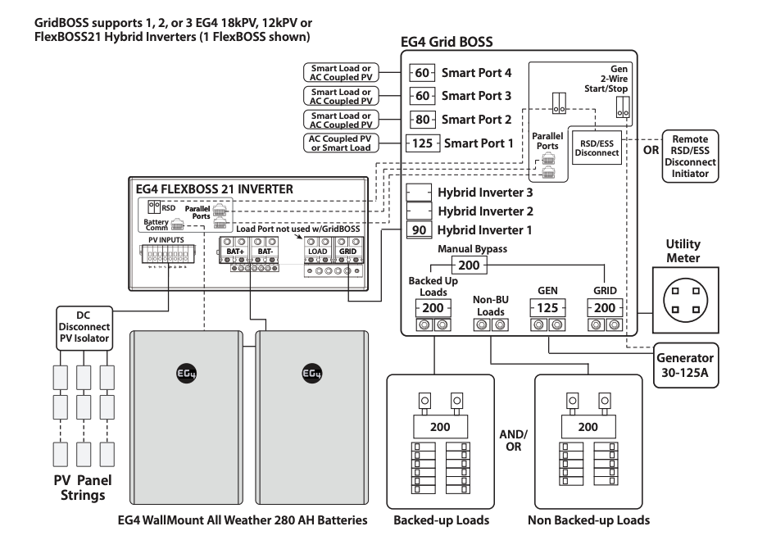
Hybrid System Diagram

Slide 26
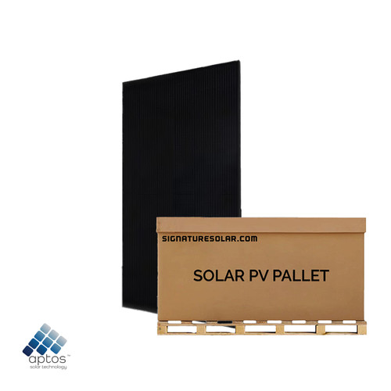
Solar Panels
Solar panels have a array of solar cells
Solar panels are measured in “watts”. - Volt x Amps here
They go from 50 watts(Toy) to 700 watt plus
History:
2020 – First 600 Watt Introduced
2020 20 Manufacturers are showing 600 watts
2024 many manufacturers are offering 700 watts
Plans over two years is 800 Watts

Slide 27
Solar Panel Cost
.0252/watt to 0.409/watt
Pallet 12.30KW x 30 Panels = $3,104.00
Panels need a place to “live” – Mounting is a important part of cost
Panels come in a variety of sizes
Above is 7ft x 3 1/3 ft x 1.3 in per panel

Slide 28
Solar Panels – Types
Bifacial – Take sun from both sides including reflections
Monocrystalline – Efficiency
Perc – Improved Monocrystalline.
Polycrystalline – Cheap and has problem with heat tolerance
Thin Film – Lightweight, flexability on size, less efficient
Choice for our app:
Bifacial Perc

Slide 29
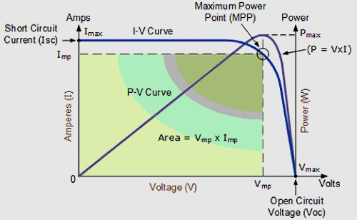
Solar Panel – Important VALUES
Open-circuit voltage (Voc) is the maximum voltage a solar panel can produce when there is no load connected to it. It's an important specification for solar panels.
VOC is used while determining the number of solar panels

Slide 30
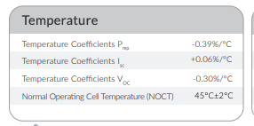
Temperature Coefficients
Hot – Use loose efficiency
Cold – You gain it – Voltage goes up
Max String Voltage should never exceed max MPPT Max input voltage

Slide 31
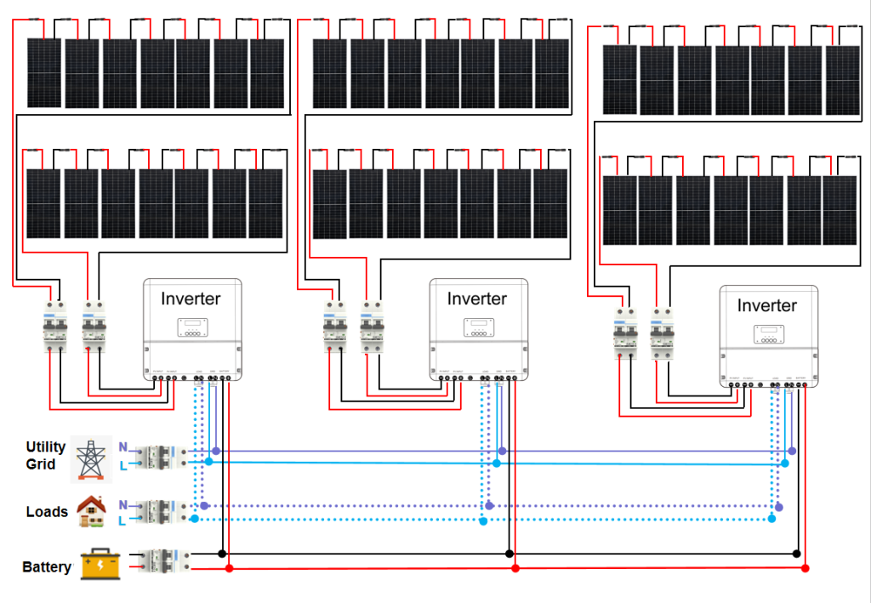
Solar Panel – DC Coupled - Design
How many MPPT/Solar Panel Inputs do we have? 1? 5? 10?
Not all strings are equal!
Each one represents a “string”
Strings can only container 1 type of panel
A string can only contain one “facing”
String implies a series connection
String VOC = Panel VOC * number of panels

Slide 32
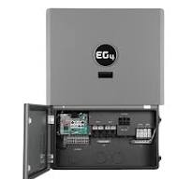
String VOC Calculation
Example Panel:
Aptos 410 W with Bifacial Gain
VOC: 48.8
String Length: 10 Panels
String Voltage: 405.6(Cold) / 484 (Normal) Volts
String Amps: 13.69A
Example Inverter:
MPPT Input Voltage: 100-600VDC
Usable Input Current: 15A Single – 26 Amp Double
Total 5 – Chains – 50 Panels –
20.5Kw per inverter – Solar Input
Double Strings – 29.31 A – Max is 31
Single String – 14.63 A – Max is 19
Notes:
Using: https://eg4electronics.com/wp-content/themes/hello-elementor/eg4-solar-panel-string-sizer/
https://drive.google.com/file/d/1Zz4Zril5--l7G8c-LOqdTsvhh8OQ12I_/view?usp=sharing

Slide 33
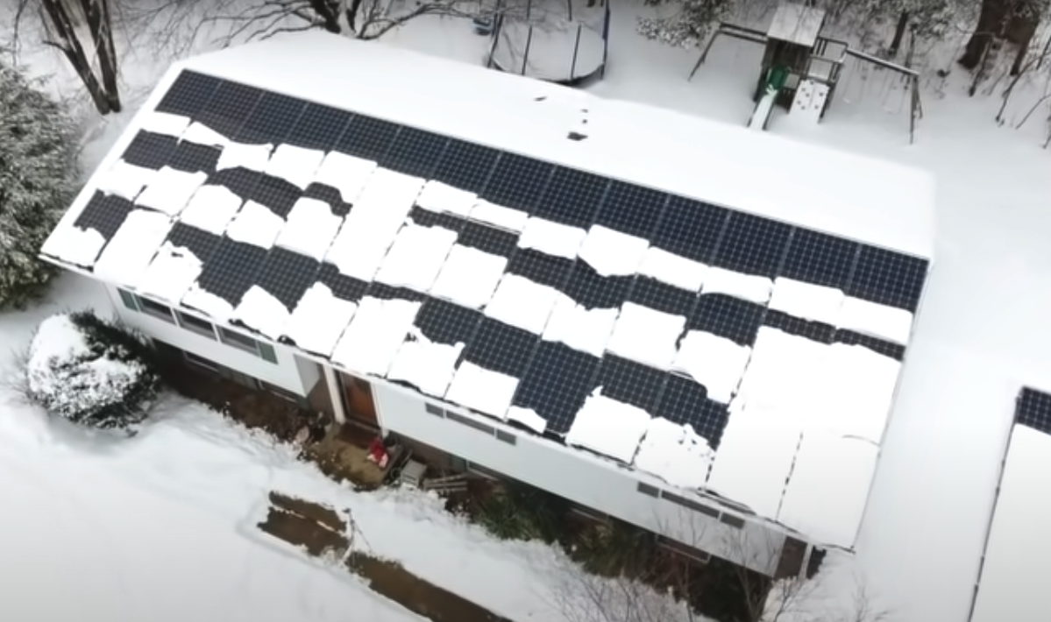
LIES – Damm Lies – Statistics Ideal ConditionS = Statistics
Panel output is 22KW (Cold Day)
Normal Temp output is 19.2kw (80f)
Horizontal Mounting = 2.5% better Annually
Cloudy Days give only 25% of typical power
Cloudy day – we get 5.5kw
Output changes with Temp
Blockage and obstructions
Cleanliness
Notes:
Vertical is better:
https://www.youtube.com/watch?v=g7pfBidv7ug
Snow and Solar
https://www.youtube.com/watch?v=UzhJvcNdwM8

Slide 34
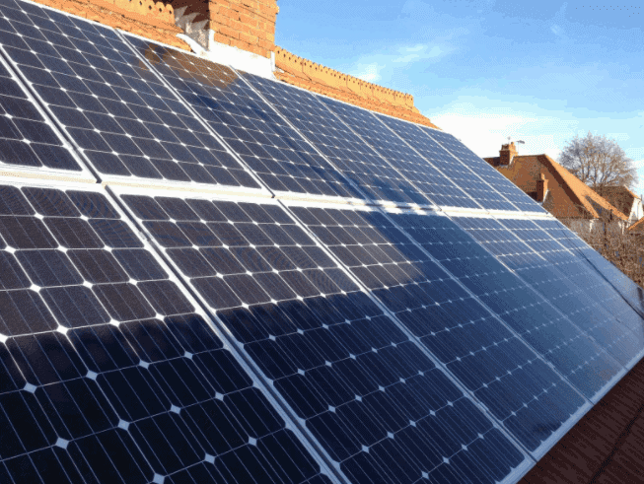
SOLAR PANELS – Mounts
Roof Mount
Ground Mounts
Vertical Mount
Solar Fence

Slide 35
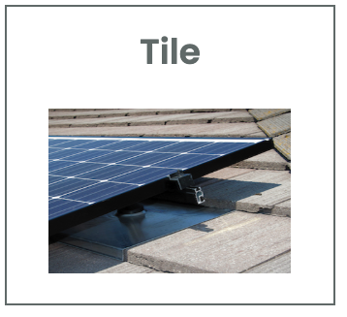
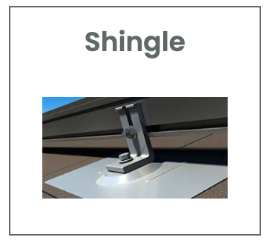
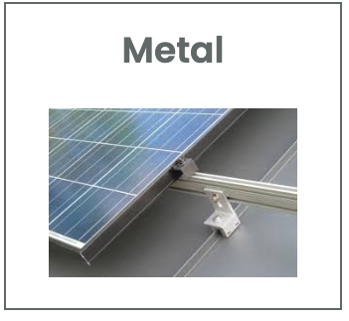
Solar Panels - Roof Mounts
Depends on Roof Type
Roof Penetrations are always a problem
Racks
Best solution
Metal Roof with Standing Seam PV-KIT 2.0

Slide 36
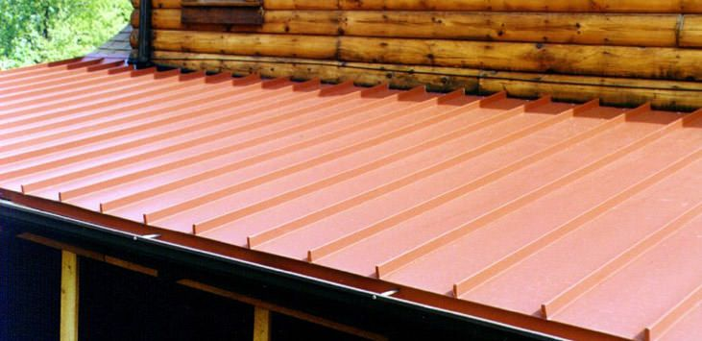
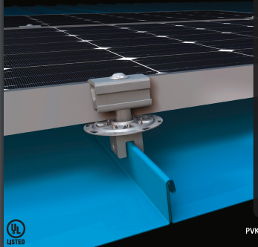
Solar Panel – Standing Seam METAL ROOF - PV-KIT
Strongest Roof
Solar Panels connect using a simple adapter.
S-5! PV Kit 2.0
Screws to the standing seam
No roof Penetration
The PVKIT 2.0 continues to be the easiest, most cost-effective way to install solar panels directly to standing seam and exposed fastener metal roofs
Notes:
PVKIT 2.0 Brochure
https://f.hubspotusercontent00.net/hubfs/3482954/Resources/Product%20Documents/Solar/PVKIT%202.0/pvkit-2-0-brochure.pdf

Slide 37
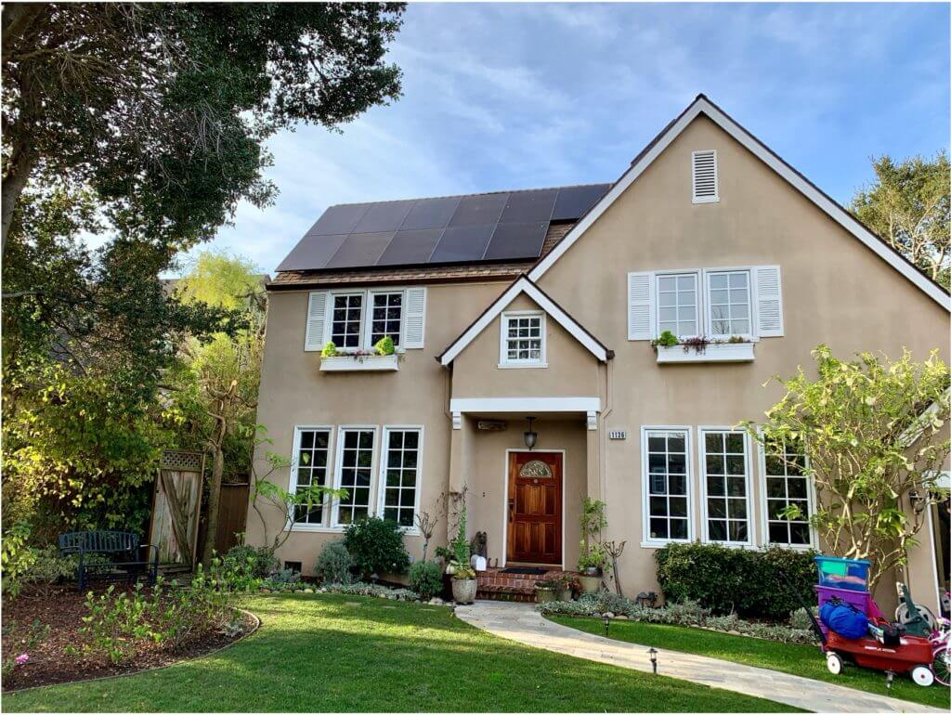
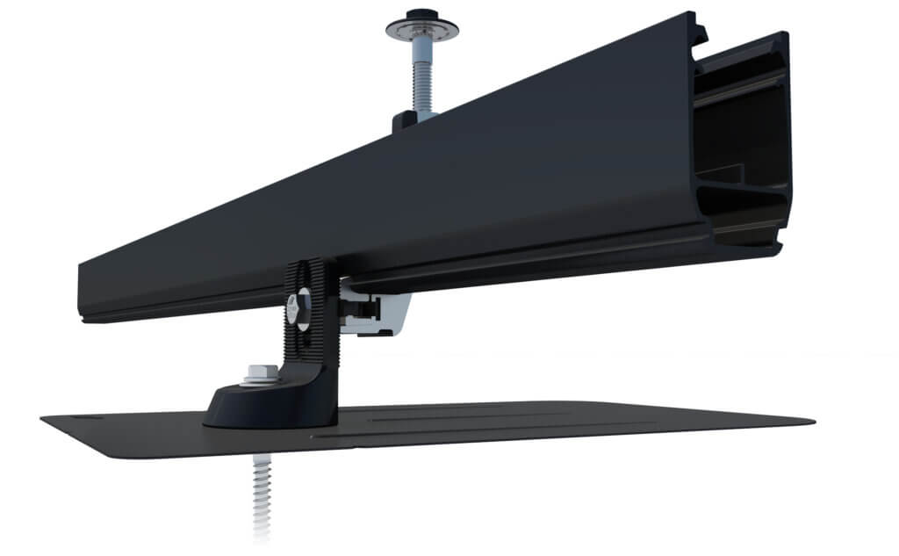
Solar Panel – ROOF RACKS
Ironridge@ – Flush Mount System
Penetrates roof
Water Leakage becomes problem
Need more careful install
Removal needs sealing
Roof Waranty issues
Needs Rails
Cost
Proven in florida weather
25 Year warranty
Notes:
https://www.ironridge.com/

Slide 38
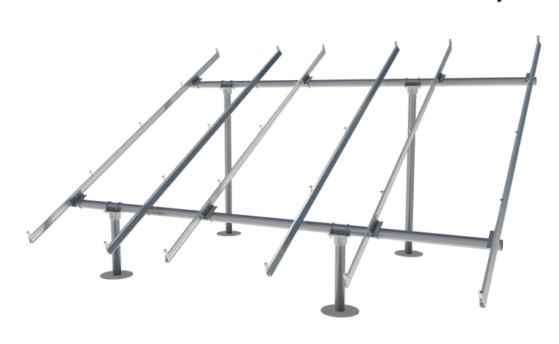
Solar Panel - Ground Mounts
Ground Mount is bit more expensive than roof mounts
Issues:
Consumes space
Handles wind Speeds?
Cost – Variable
Dual Use Possible
Notes:
IntegraRack
https://www.youtube.com/watch?v=zrvf_pqeNH0
https://www.currentconnected.com/product/integrarack-ir-30-solar-panel-ground-mount-bracket-30-degree-angle-individual-frame/?ref=wp

Slide 39
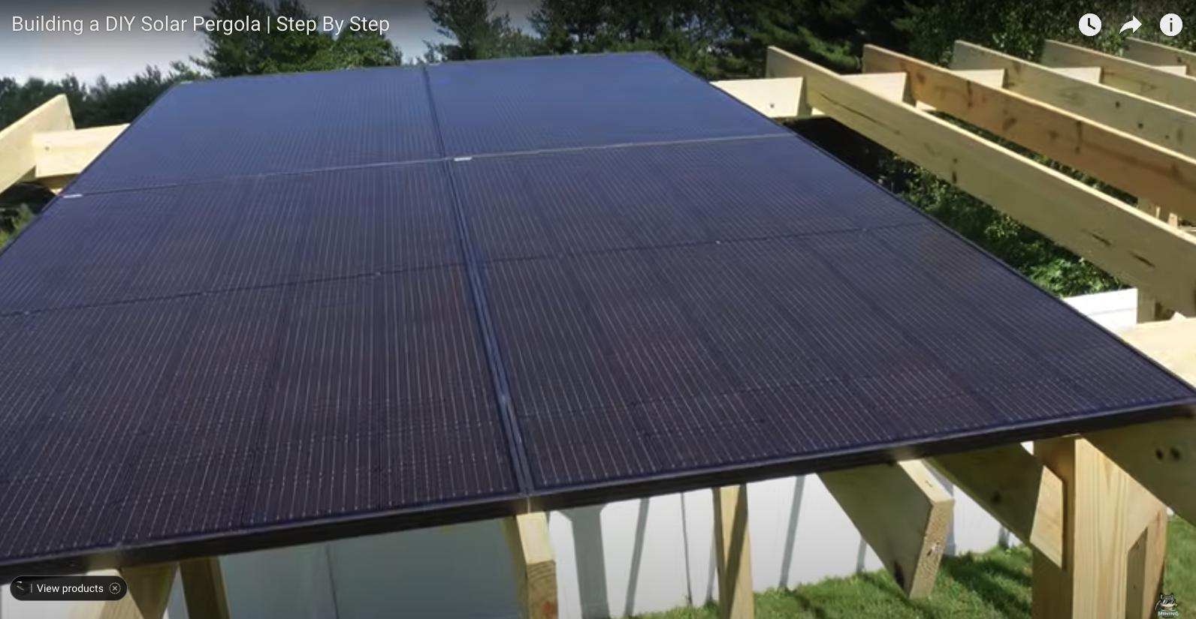
Solar Panel - Pergola
Made out of wood/metal
Dual Use Space
Source from Lowes
Scalabiltiy issue with large panel counts
Solar Panel Greenhouse ☺
https://www.youtube.com/watch?v=vLGzAscPr5k&t=190s
Notes:
https://www.youtube.com/watch?v=vLGzAscPr5k&t=190s

Slide 40
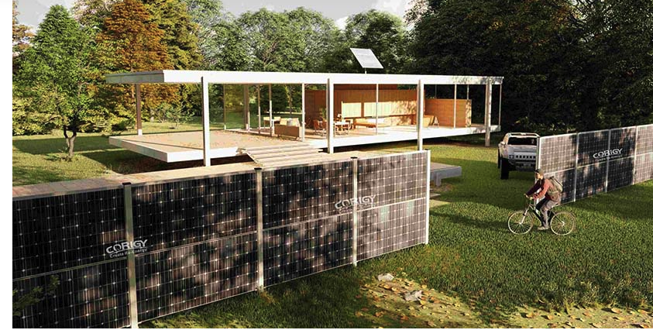
Solar Fence
Vertical Mount – 2.5% better
Dual Usage
Can use a variety of mounting –
Concrete I-Beam Fence Posts
Aluminium I-Beam for Solar
Life Time Steel Post - $39.99 ea

Slide 41
Solar Panels – Safety
Electrical Safety – DC
Single Panel = 50V with 10 Amps – ARC Welding is 50-60V DC
Multiple Panel – 400V to 600V – 10 amps = 8000 Watts Instantly Available
ARC Flash and ARC Blast are possible and likely
Use a Rapid Shutdown Device – Required in some states, should be required in all
Electrical Safety – AC
110 – 120 V AC – 60 Amps – Same String above
Wet Environemnt
Micro Inverter does do sensing
Primary protection is Breaker

Slide 42
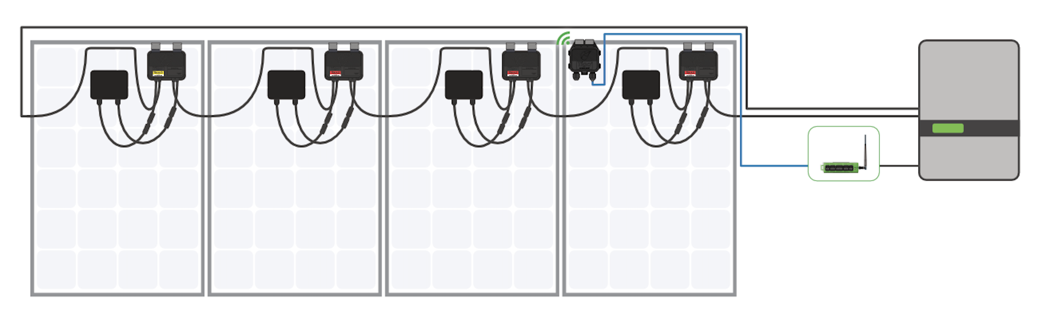
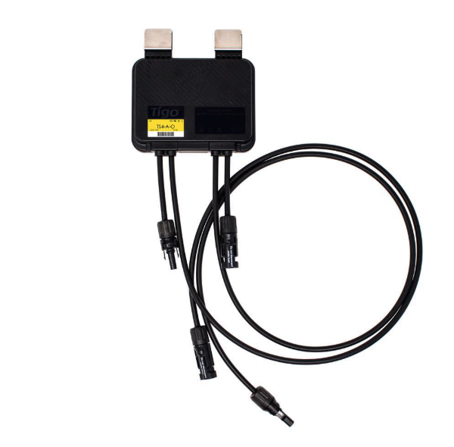
Solar Panel Safety – DC – Rapid Shutdown
National Electrical Code (NEC) 690.12 section covers rapid shutdown devices (RSDs) for solar photovoltaic (PV) systems on buildings. The purpose of RSDs is to reduce the risk of shock for emergency personnel.
Panel Output is reduced to zero
Optimizes for shading
Allows monitoring per panel
Notes:
https://www.tigoenergy.com/product/ts4-a-o

Slide 43
Inverters – types and Kinds
Micro Inverters – Mounted behind panel – Give AC output at the roof for each panel
Grid Tied Inverter – Typically no battery, centralized
String Inverter – Converts a “string” of multiple panels high voltage dc into ac.
Off Grid Inverters – Designed to power house/shed without a utility connection
Hybrid inverter – Combines Off-Grid, Grid Tied, and String Inverter into one device

Slide 44
Inverters – The ”Components”
MPPT – Solar Charge Controller - MPPT stands for Maximum Power Point Tracking. It's a technique that maximizes the amount of energy that can be extracted from a variable power source. MPPT is most commonly used in solar panels.
This may be a separate box or component or integrated into a all-in-one.
Battery Charger – This is the part that can take either the output of the MPPT or AC from utility, convert to battery voltage (48V For example) and monitor and charge battery.
Inverter – The component that can take “power” from solar and convert it to AC.
Bypass – This part allows the 200A mains ac to go thru the inverter when battery is low.

Slide 45
Batteries – Types and KINDS
Li-ion – High Density but prone to fire. (That cannot be put out)
LiFePO4 - Stable, less likely to catch fire. 4-5 times the life of lithium ion, easy to recycle
Deep Cycle Lead Acid – Old School, still around but not recommended. Density is low, Mostly being taken over by LiFePO4, that “look” like Deep cycle.
Sodium Ion (Future) – New Sodium battery, that offers the benefits at LiFePO4 at lower cost. TBD as it emerges.
Solid State Batteries (Future) – Coming soon – highest density lowest cost per watt. Video attached.
Notes:
BYD CEO Announces All New Solid State Batteries With 10 ...
YouTube · Wallay Blue4 days ago

Slide 46
METER to inverter (MID) “Accessories”
Traditional solution needs:
Breaker Panel with connection to meter
A breaker for each inverter
A Bypass Switch (200 Amp) to bypass the inverter
A Breaker panel to inverters input
A breaker panel for inverters output
Generator input distribution panel
To connect each inverter
Messy yet? (Have the design with part numbers if someone really wants to do this)

Slide 47
Module 2 – Physical Plant/Design Implementation
Inverter Choice
Battery Choice

Slide 48
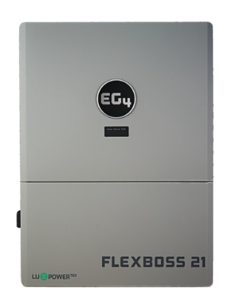
Hybrid Inverter – All IN ONE
FlexBoss 21 –
16kw Power Output per inverter
21kw Solar Input
To make this simple to install – We will use a “Hybrid” all-in-one inverter.
This has all the components, except the bypass.
Software/settings control its operating mode.
Complete solution for offgrid for 16kw and up to 50 +/- panels

Slide 49
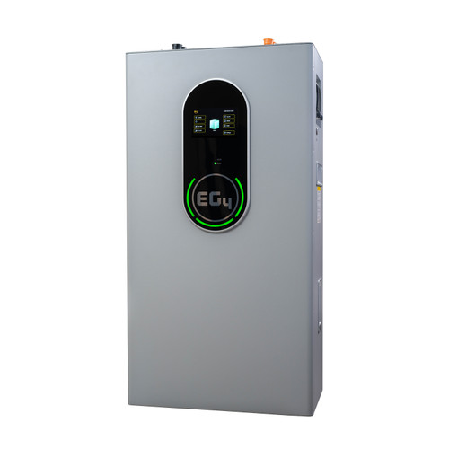
Battery –Our Choice
EG4-WallMount Indoor Battery
48V 280Ah
14.3kWh
Indoor
Heated
UL1973, UL9540A
10-Year Warranty
Wall Mount 280Ah LiFePO4 with a BMS
BMS Handles monitoring battery, and balances it.
Heating System to control temp
Built In Fire Arrestors
48 Volt (54V Actual) – Why?
200 Amp continuous, recommended 60A to 120A
Recommended watts out = 8.3 Kw
For two inverters – 4 batteries is recommended – Giving 33.2kw

Slide 50
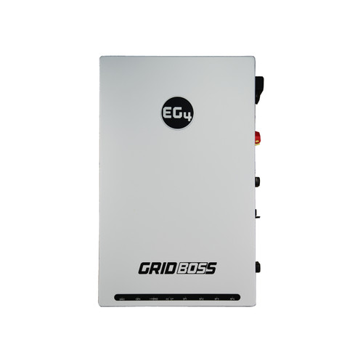
MID – Better Solution
EG4 Gridboss
Service Entrance
Breakers for up to 3 inverters
Grid Bypass
Generator input and control
Wires / Breakers:
Meter to Gridboss (200 Amp)
Gridboss to Main Panel (200 Amp)
Up to 3 wires to inverter (90-125 Amps)
Generator Input (Up to 125 Amps)
Typical is 5 or 6 wires complete for AC
Real Time Monitoring
Smart Ports allow system to be used to shed/electric car etc without further breakers, and ability to software control

Slide 51
Solution Overview - Connections
Gridboss
Connection to Meter
Connection To Generator
Connection To Main Panel – Main House
Connection To Barn (Via SmartPort)
Connection To PowerPod (Via SmartPod)
Connection to HvacPod (Via SmartPort)
Connection To
Connection to (2) Inverters
Inverter(s)
Connection to Gridboss
Connection to 50 Solar Panels (DC)
Connection to Battery(s) (x4) (DC)
Connection to BMS on Battery (Data)

Slide 52
Where oh WHERE to put all of this?
4 Batteries
1600 Amps at 48V of capacity
3 Devices handling 100’s of amps
Meter
Need to connect to multiple places/buildings
Early Operations
Possible Solutions:
Garage of main houses
On outside wall of main house
Barn? Inside / Out
Or something else

Slide 53
Power-POD
Power-Pod is a 20 foot shipping container.
Its finished:
Internal Steel Framing
Spray Foam Insulation
For Temp Control
For Strength
¾ Inch CDX Fire-Retadant Preassure-Treated Plywood
5/8-in Fire Resistant Type-X Drywall
Pod Contains:
Utility Meter – Mounted on exterior – Designed for above or below ground
GridBoss – Our Power HUB
Up to 3 inverters
Up to 6 batteries
One Air-To-Water Fan Coil
Cooling of equipment
Radiant Floor Heating
Environment Monitoring
Smoke Alarm
Rapid Shutdown Equipment for Solar
Notes:
https://www.homedepot.com/p/3-4-in-x-4-ft-x-8-ft-CDX-Fire-Retardant-Pressure-Treated-Plywood-368211/309628627
https://www.lowes.com/pd/Gold-Bond-5-8-in-x-4-ft-x-8-ft-Fire-Shield-Drywall-Panel/5001613083?idProductFound=false&idExtracted=false
https://www.amazon.ca/Container-Modification-World%C2%AE-Containers-Composite/dp/B0D4XG88WJ/ref=sr_1_20?dib=eyJ2IjoiMSJ9.h21JF1pd6CWgQlIQ1wmLcQ6qTVVXyyLk6WRsZupip-Ig8jQ3bENYJcLYwE5goJOViI4CnrA1_7BgiDCfbIaITDUjoYNvFBDuF0z82TXaes9SUkgWepvffJjttskofc4VEtxYrV79wRkMypwRQsF3dyndWGxf3LjiL7kakuCl0tIt0aPTxrErT9HXt--5DChTDH9_DABG6DIYy26-ieE-zKsH-916YdA6cEBJoB9nadpEhlh9N-lP_2GtIjPN--gOseNG5vPRYxSYSA5bbcCyZUE30FYYlkK21auqMrT_6RrjSR5y-3aBKg9v6JrbGqs7i4fr-3O0lFIjx4vGNj_kvNQ4s9u20eiSUew1dd15hcCKSk2KufdaectEYqOzglh_xnWzF-gcoavQTPSs2sUaS4uGBTdLGxCmVNwOb3DnAAMVSsvpBXaLAHKhBu1I9XLo.K3peL0zeNjAglH-zXMTaNpRyFIIQhDwDjfiX7CCzwiQ&dib_tag=se&keywords=Container%2BModification%2BWorld&qid=1736526763&sr=8-20&th=1

Slide 54
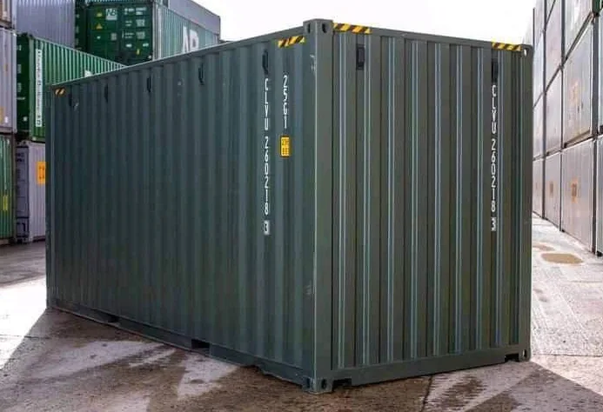
Power pod - Container
20 Foot High Cube 1-Trip Container
20ft long x 8ft wide x 9ft 6in tall
Notes:
https://worthycontainer.com/20ft-high-cube-new-shipping-container-one-trip-memphis-tn/

Slide 55
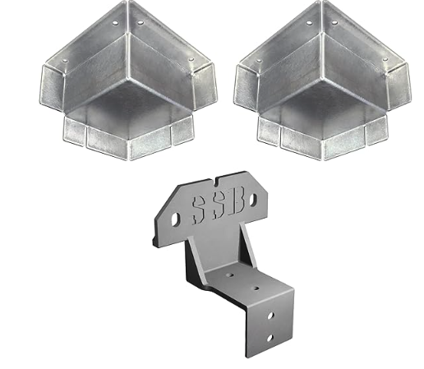
PowerPOD Framing
Container Modification World® - Steel Stud Framing Kit for Shipping Containers/Sea Cans (Composite) - 2 Corner Casting Covers Steel Stud Brackets Hardware (20)
1”5/8 Steel Studs for sides
2.5 Inch Studs on Roof
Door Flashing Kit
Notes:
Container Modification World® - Steel Stud Framing Kit for Shipping Containers/Sea Cans (Composite) - 2 Corner Casting Covers Steel Stud Brackets Hardware (20)
https://www.amazon.ca/Container-Modification-World%C2%AE-Containers-Composite/dp/B0D4XG88WJ/ref=sr_1_20?dib=eyJ2IjoiMSJ9.h21JF1pd6CWgQlIQ1wmLcQ6qTVVXyyLk6WRsZupip-Ig8jQ3bENYJcLYwE5goJOViI4CnrA1_7BgiDCfbIaITDUjoYNvFBDuF0z82TXaes9SUkgWepvffJjttskofc4VEtxYrV79wRkMypwRQsF3dyndWGxf3LjiL7kakuCl0tIt0aPTxrErT9HXt--5DChTDH9_DABG6DIYy26-ieE-zKsH-916YdA6cEBJoB9nadpEhlh9N-lP_2GtIjPN--gOseNG5vPRYxSYSA5bbcCyZUE30FYYlkK21auqMrT_6RrjSR5y-3aBKg9v6JrbGqs7i4fr-3O0lFIjx4vGNj_kvNQ4s9u20eiSUew1dd15hcCKSk2KufdaectEYqOzglh_xnWzF-gcoavQTPSs2sUaS4uGBTdLGxCmVNwOb3DnAAMVSsvpBXaLAHKhBu1I9XLo.K3peL0zeNjAglH-zXMTaNpRyFIIQhDwDjfiX7CCzwiQ&dib_tag=se&keywords=Container%2BModification%2BWorld&qid=1736526763&sr=8-20&th=1
https://www.homedepot.com/p/ProSTUD-20-1-5-8-in-x-10-ft-20-Gauge-EQ-Galvanized-Steel-Wall-Framing-Stud-162PDS125-18/311149448

Slide 56
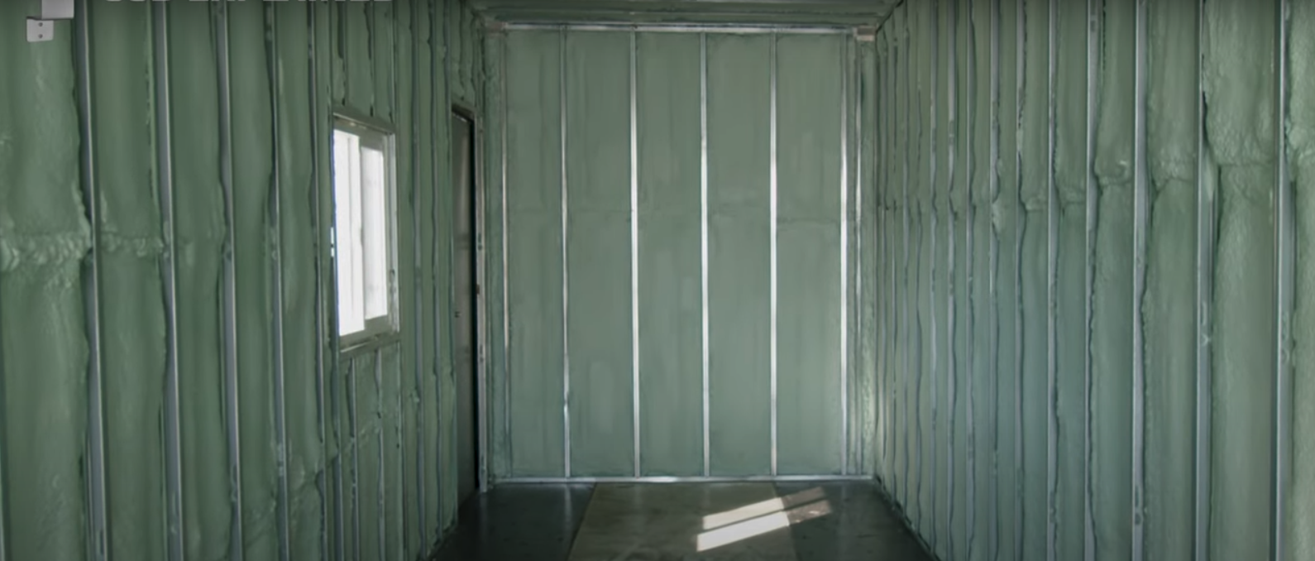
PowerPOD Insulation
Spray Foam
Provides vapor barrier
Thermal Break
Increases Strength of Walls/Ceiling
Notes:
Add PestPlug to block pest and spray foam

Slide 57
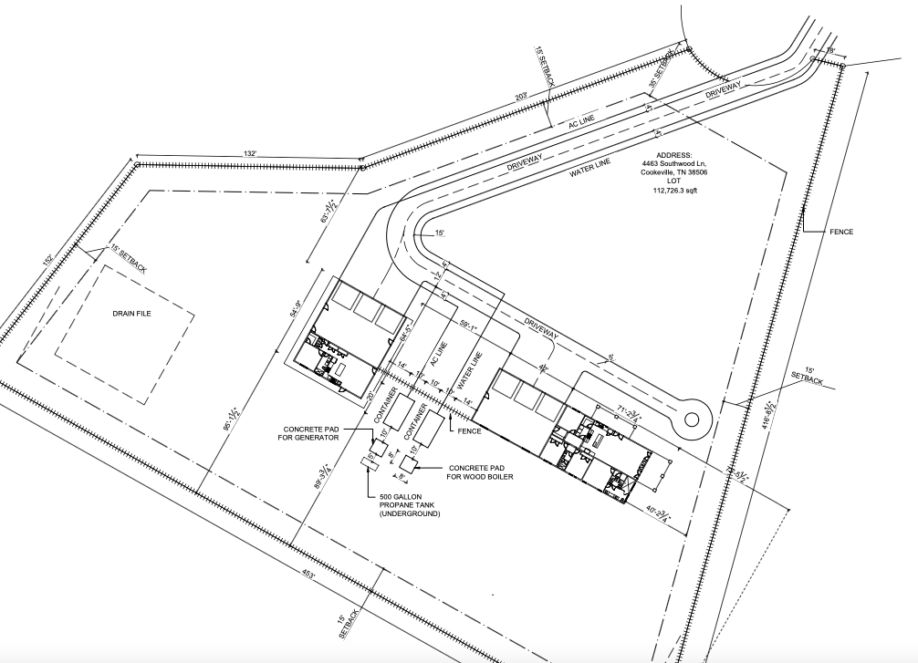
Overall Site Plan

Slide 58
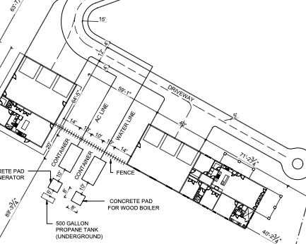
Containers

Slide 59
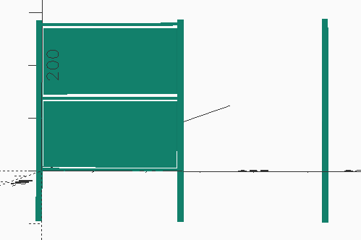
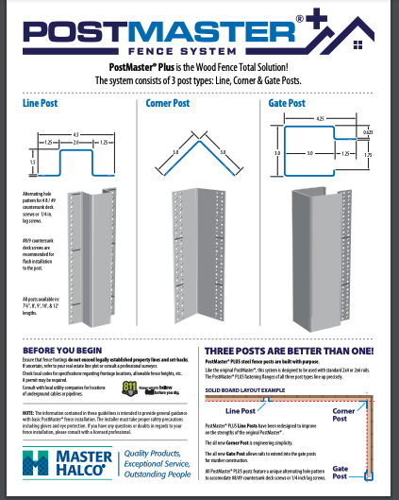
Solar Fence
PostMaster Fence Post
10 Foot – Steel Post
3.5 inch – 1.5 inch with 1 inch either side
Qty 3 - OpenBuilds 4040mm Aluminium Rails
Custom Cut to 2160mm (Estimate)
Bottom/ Top mounting plate – powder coated steel (Oshcut) – drilled for panel holes and matching holes for rails
Middle Plate – powder coated steel (oshcut) – drilled for panel holes and matched holes for rails

Slide 60
Module 3 – Electrical and settings
Wiring The Inverter
Inverter Settings

Slide 61
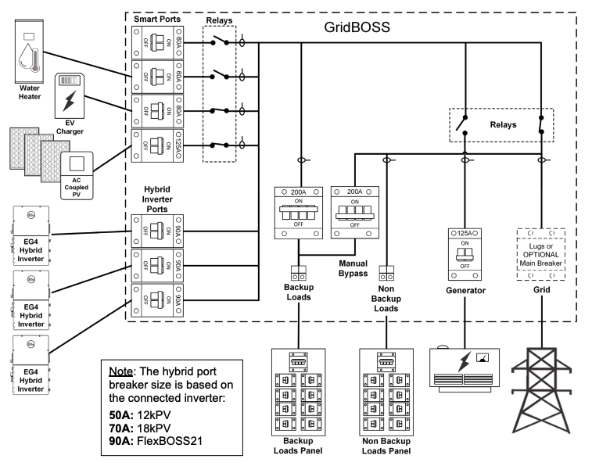

Slide 62
Equiping Breakers
Main Breaker – 200 Amp
Inverter 1 Breaker – 90 Amp
Inverter 2 Breaker – 90 Amp
Generator Port – 80 Amp
Smart Port 1 – 125 Amp – For Barn Connection
Smart Port 2 – 80 Amp - For HVAC Container
Smart Port 3 – 60 Amp - For Electric Car Charger
Smart port 4 – 60 Amp - Power for Power Pod (Internal)

Slide 63
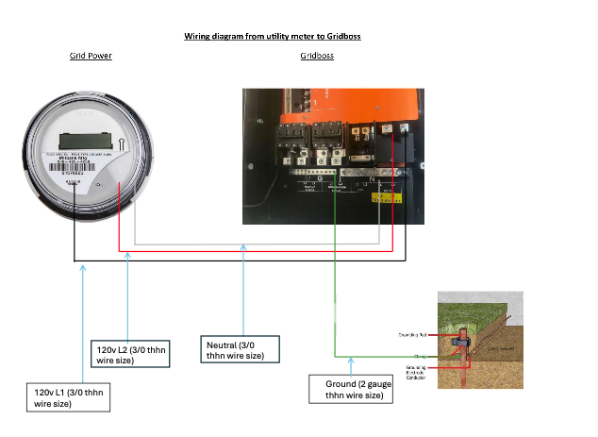
Wiring from Utility meter to Griid Boss “Wire 1 and Ground”
120v L1 – 3/0 thhn wiresize
120v L2 – 3/0 thhn wiresize
Neutral - 3/0 thhn wiresize
Ground - 2 gauge thhn wire size

Slide 64
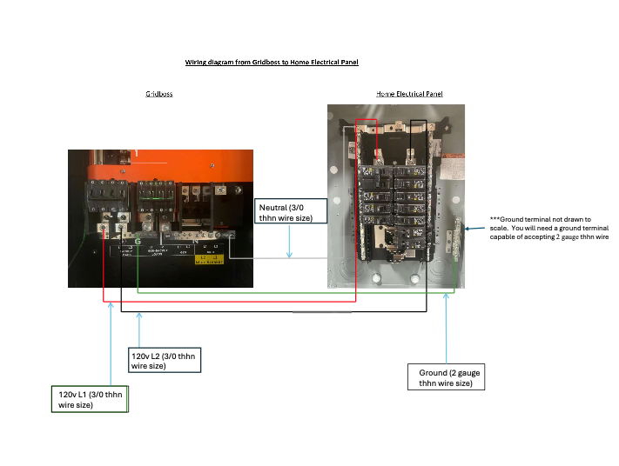
Wiring from gridboss to home electrical panel – “Wire 2”
120V L1 – 3/0 thhn wire size
120V. L2 - 3/0 thhn wire size
Neutral – 3/0 thhn wire size
Ground. - 2 gauge wire size

Slide 65
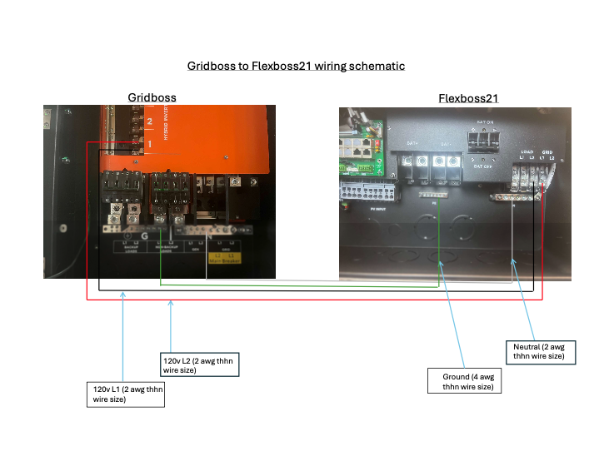
Wiring from gridboss to Inverter 1 (Flexboss 21) – Wire 3
120V L1 – 2 awg thhn wire size
120V L2 – 2 awg thhn wire size
Ground – 4 awg thhn wire size
Neutral – 2 awg thhn wire size

Slide 66
Wiring from gridboss to Inverter 2 (Flexboss 21) – wire 4
120V L1 – 2 awg thhn wire size
120V L2 – 2 awg thhn wire size
Ground – 4 awg thhn wire size
Neutral – 2 awg thhn wire size

Slide 67
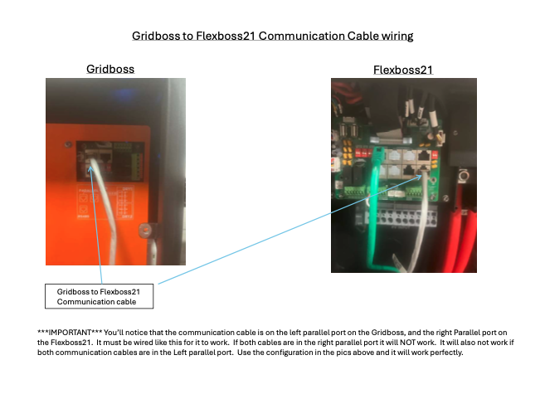
Gridboss to Flexboss 21 Communication WIRING
Using standard “ethernet” cable
RJ45 Both Ends
4 Pair – 8 conductor cable
Low Voltage
Connect to left parallel port on Gridboss
Connect to right parallel port on Flexboss

Slide 68
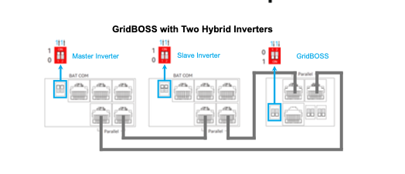
Connecting our 2 inverters - Data

Slide 69
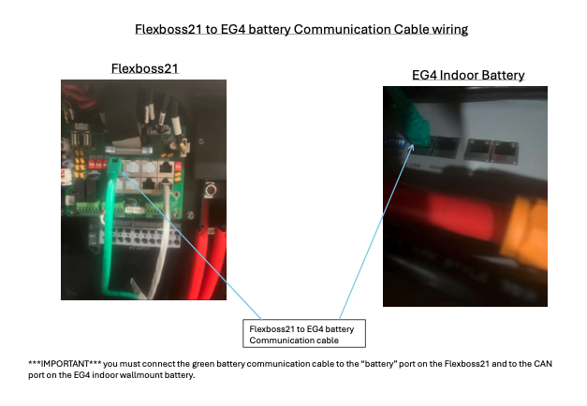
Flexboss 21 to Battery
Using standard “ethernet” cable
RJ45 Both Ends
4 Pair – 8 conductor cable
Low Voltage
Green Color
Connect “battery port” on Flexboss and to the CAN port on the EG4 indoor battery
Daisy Chain this from battery to battery

Slide 70
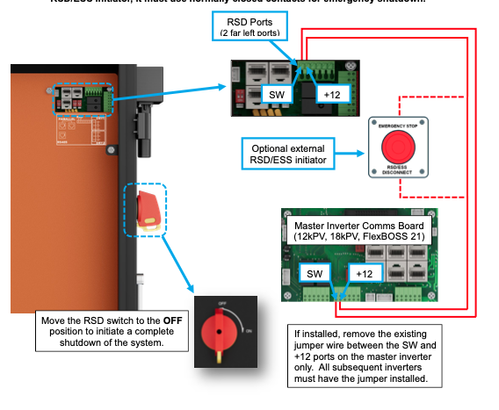
Rapid Shutdown
Gridboss supports rapid shutdown system that complies with 2017 and 2020 NEC 690.12 and ESS Disconnect that complies with NEC 706.15
Switch on the right side of gridboss, when used will initiate total system shutdown, including the inverters, supported batteries, and PV (If using Tigo rapid shutdown devices)

Slide 71
Settings - Intent
Use as much Solar for loads as possible
50% should be able to charge batteries as well
Use battery before grid on a cloudy day
At 8pm – Charge battery to full – if below 50%
Bad weather Expected – Charge to full from grid as soon as possible
Never send power to grid
At start of day, if battery below 30% charge to 60%
If batterys are at 30% and no grid, charge from generator, turn off generator at 90%

Slide 72
Settings
Power Backup: Enable
We are Now a “UPS” for house
No Grid Sell Back
No electricity will be sent to the public grid
Fast Zero Export – Adjust power so there is no power export instead of every 5 seconds
Off-Grid Mode – Allows absolute zero-export when there is a AC Connection, only will charge if AC Charge is enabled
RSD: Enable Rapid Shutdown
Share Battery: Yes
AC Charge:
AC Charge Enable
AC Charge Based On: Time
Set AC Charge Power:

Slide 73
Settings
PV Charge Prioirty: Priortise Solar
PV Charge Power: 12kw (Per Inverter
Offgrid Dischage Cutoff : 20%
Weather Optimization:
Intelligent Charging Control
Working Mode: Self Consuption

